Slide 1
Student Management System

Slide 2
Student Management System
Overview
Core Functionalities

Slide 3
Overview
Our Student Management System is a software solution that streamlines the administration of educational institutions by automating processes such as student enrollment, attendance tracking, and grade management.
It organizes course offerings, facilitates communication between students, parents, and faculty, and generates detailed reports on performance and attendance.
By providing user management features for different roles, an SMS enhances efficiency, reduces paperwork, and improves the overall educational experience for all stakeholders.

Slide 4
Core Functionalities
Student Management
01
Adding, editing, and deleting Student records.
02
Cataloging Students based on their merit,Roll No, etc
03
Tracking academic history .

Slide 5
Core Functionalities
Attendance Management
01
Managing attendance of students
02
Tracking attendance percentage
03
Tracking Event absence.

Slide 6
Core Functionalities
Student Aid
01
Aid students in applying for schemes.
02
Aid students in managing events.
03
Manage student submissions.

Slide 7
Core Functionalities
Cataloging and Search
01
Creating and maintaining a Student catalog.
02
Providing search functionalities for searching student data.

Slide 8
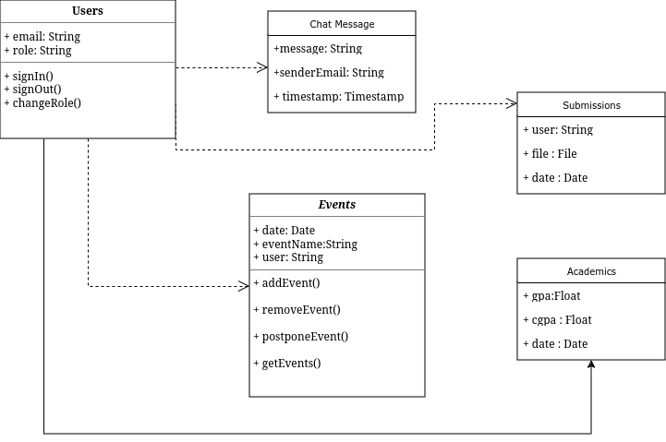
Class Diagram

Slide 9
Database
Firebase
Fast
Easy to use
Secure
Realtime Database

Slide 10
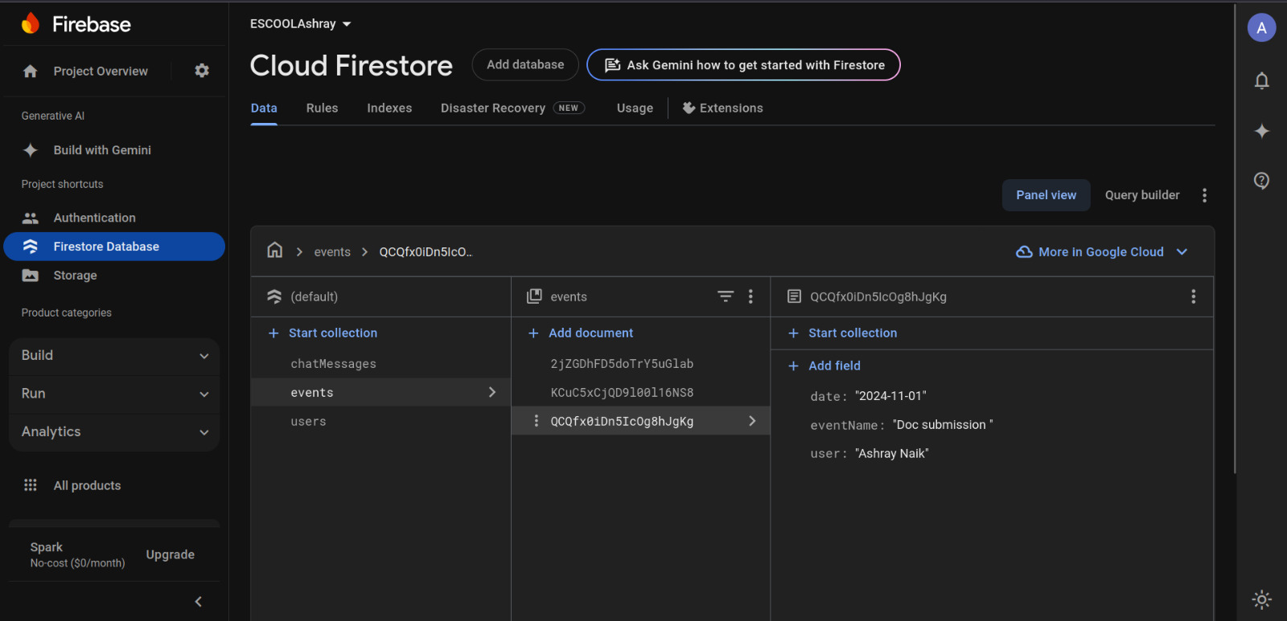
Firebase

Slide 11

Firebase

Slide 12
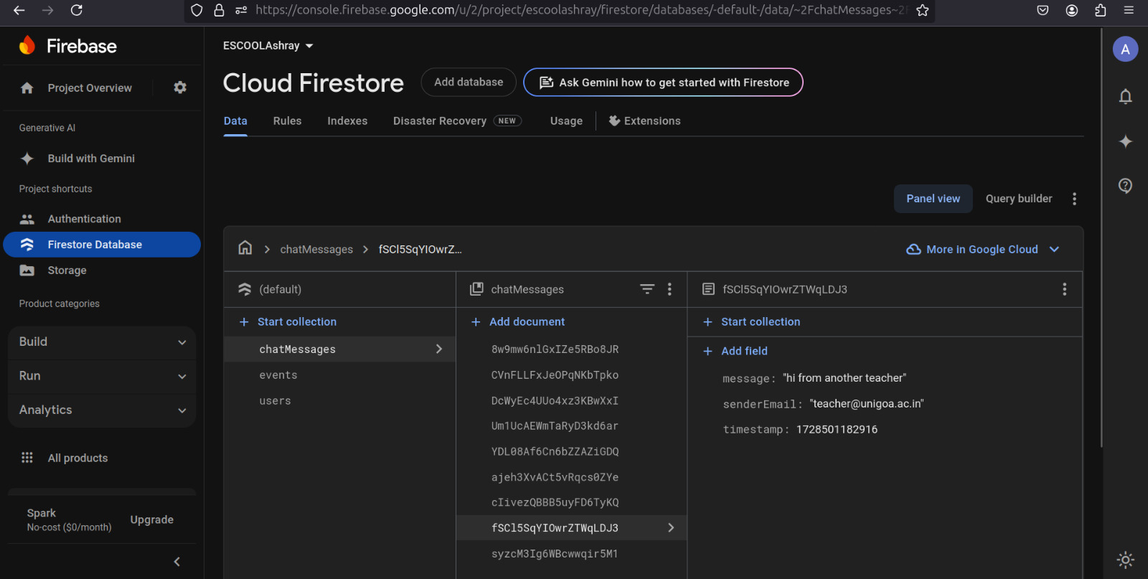
Firebase

Slide 13
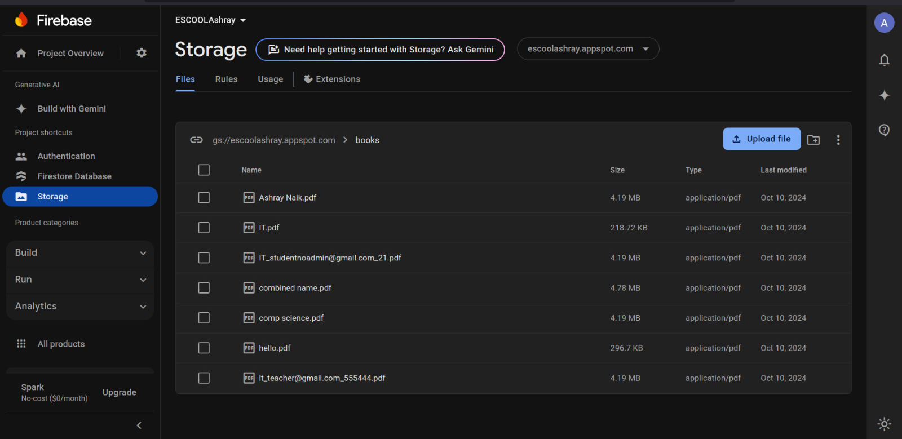
Firebase

Slide 14




Thank you!

